Slide 1
Employee Management System
Python and MySQL Console based Application
Jitendra Kumar Dubey
(206612)

Slide 2
Project Overview
Introduction:
An Employee Management System built using Python and MySQL.
Designed to manage employee data, including adding, viewing, updating, and deleting records, searching employee by their unique id or by name.

Slide 3
Tech Stack
Programming Language: Python
Database: MySQL
Libraries/Modules:
mysql.connector for database connectivity.
bcrypt for password hashing.

Slide 4
Key Features
Login/Register:
Register new employees.
Login Functionality
Employee Panel:
Add New Employee
View Employees
Update Employee
Delete Employee
Search Employee (by id or name).
Security:
Passwords are hashed using bcrypt.

Slide 5
Database Structure
Table: employees Table: users
id (Primary Key) id (Primary Key)
name username
age password
department
Salary

Slide 6
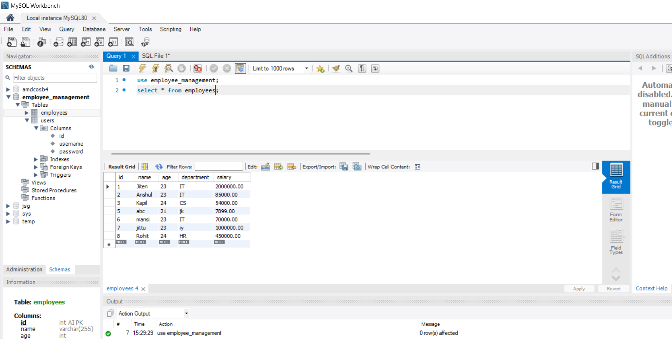
Employee Database

Slide 7
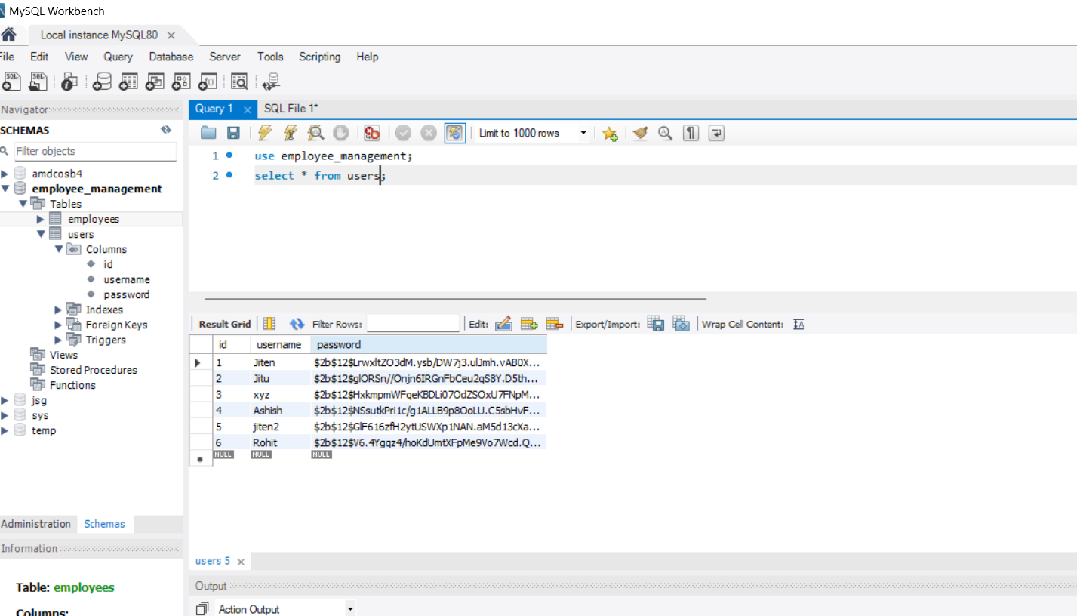
User DataBAse

Slide 8
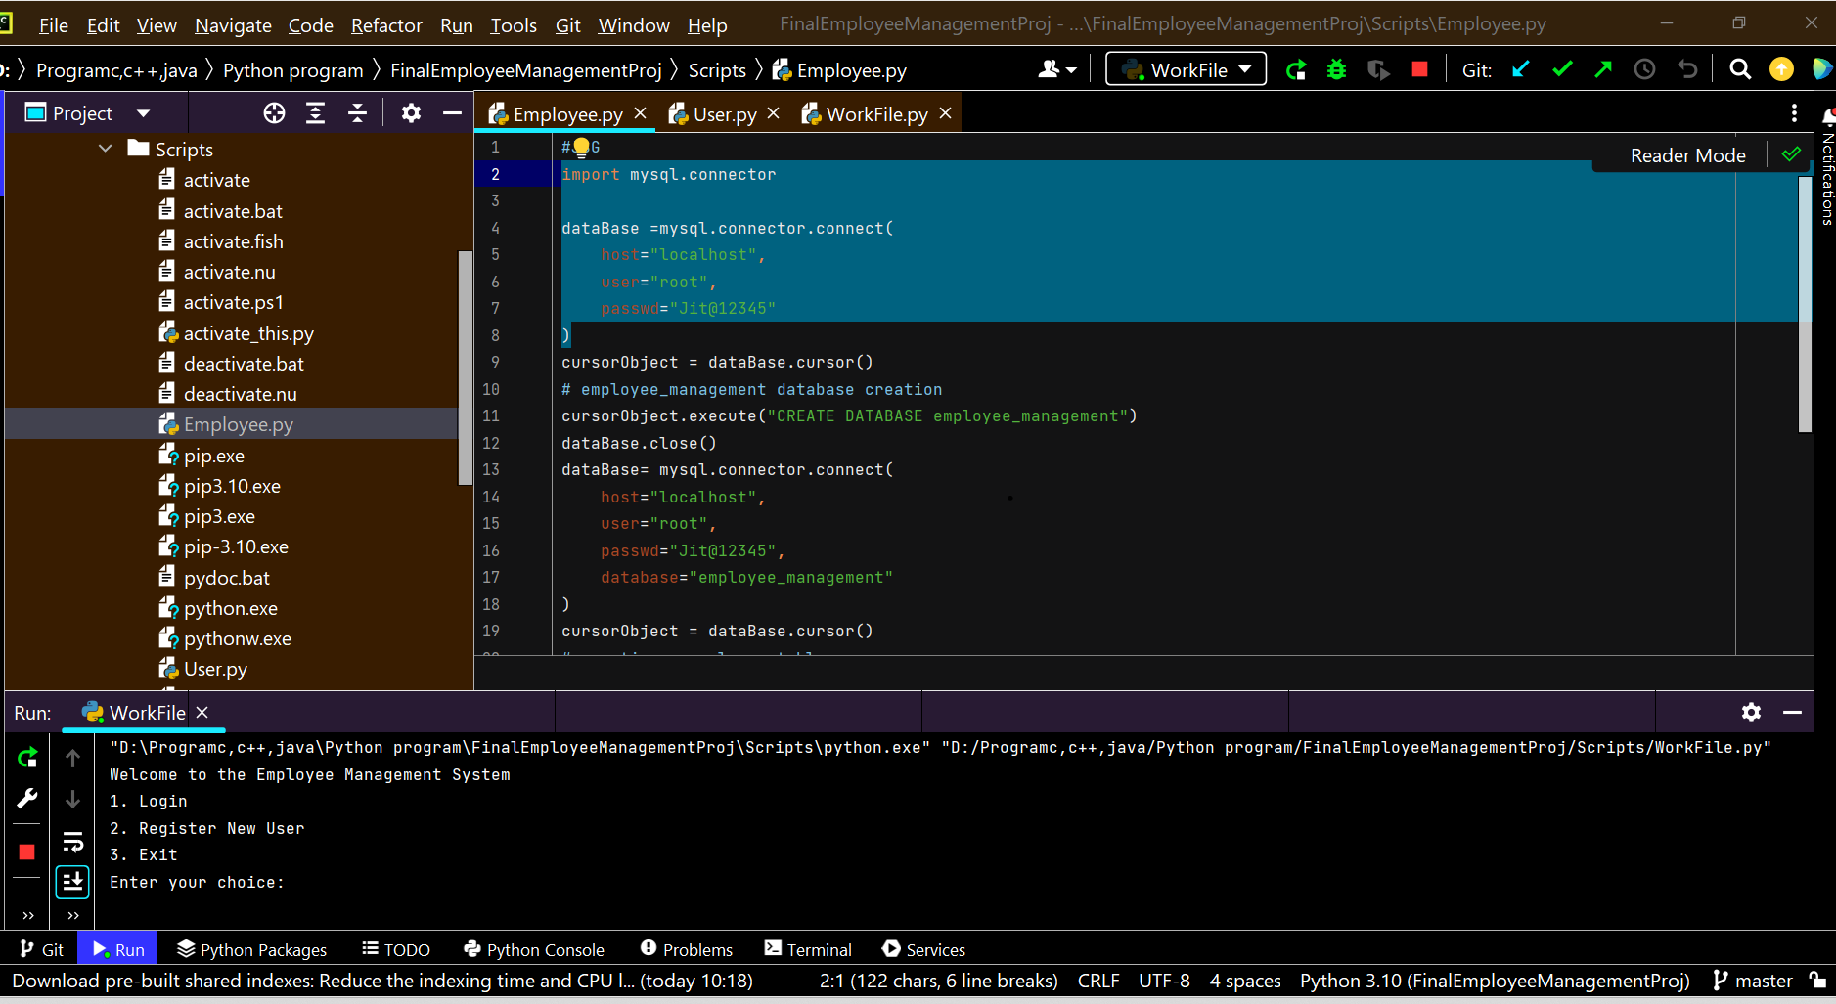
Outputs Snippet
Home Page for EMS

Slide 9
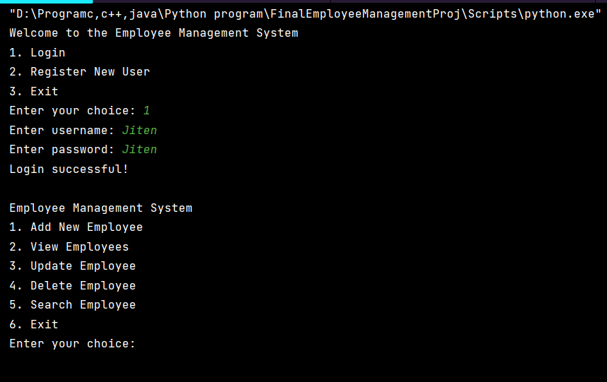
Login

Slide 10
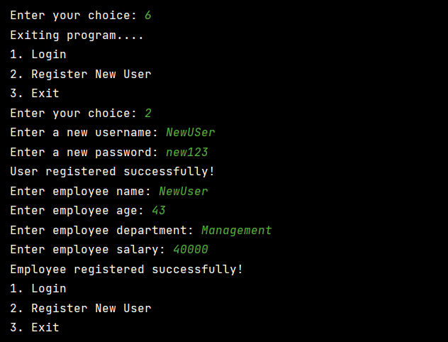
Register a new user

Slide 11
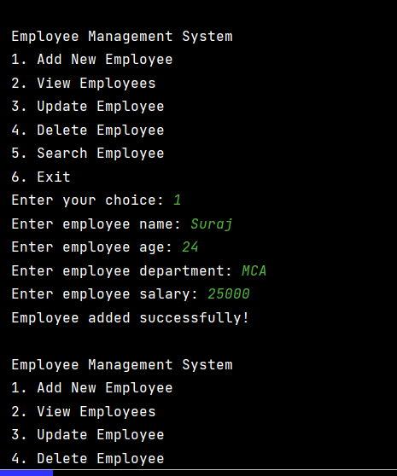
Add Employee

Slide 12
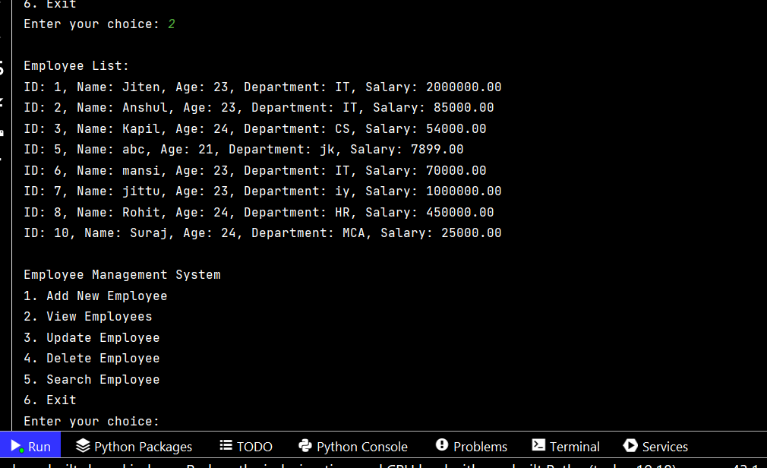
View employees

Slide 13
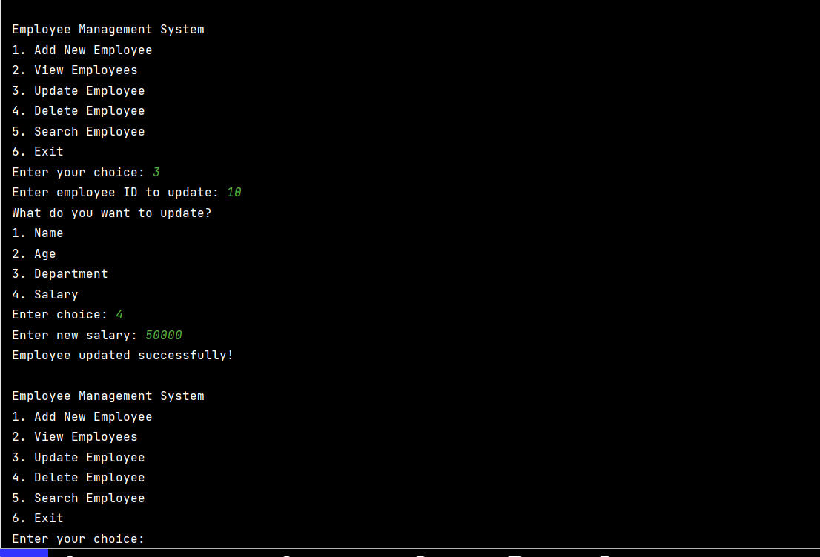
Update Employee

Slide 14
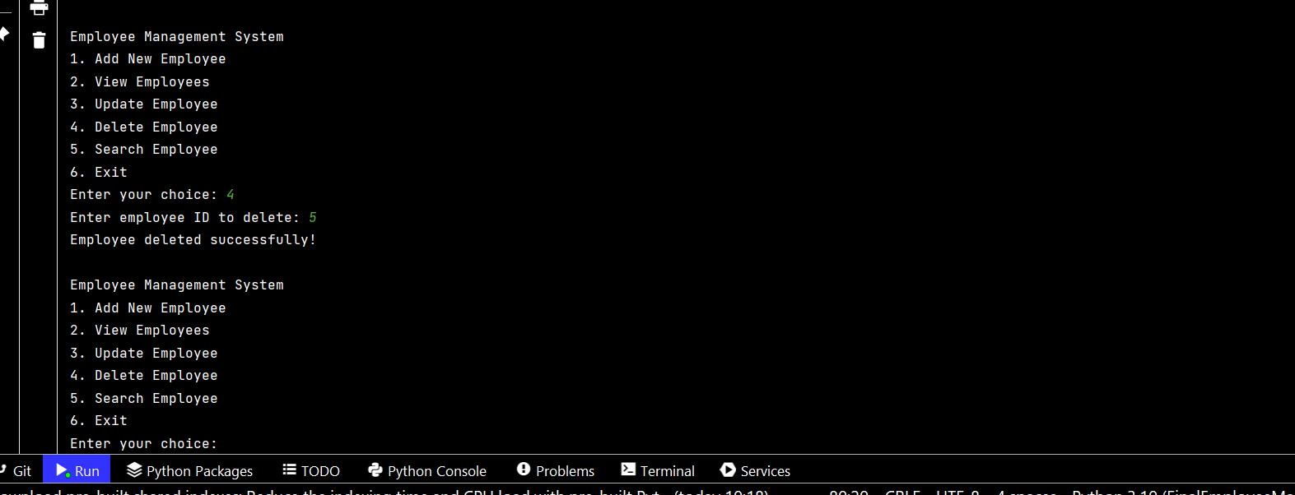
Delete Employee

Slide 15
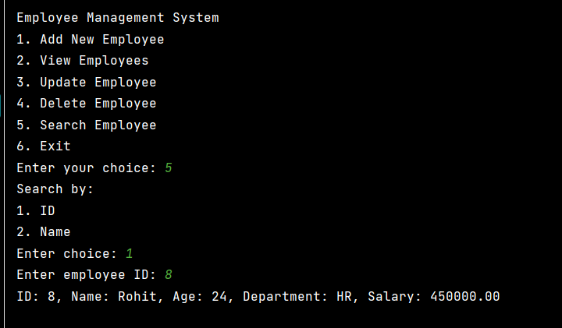
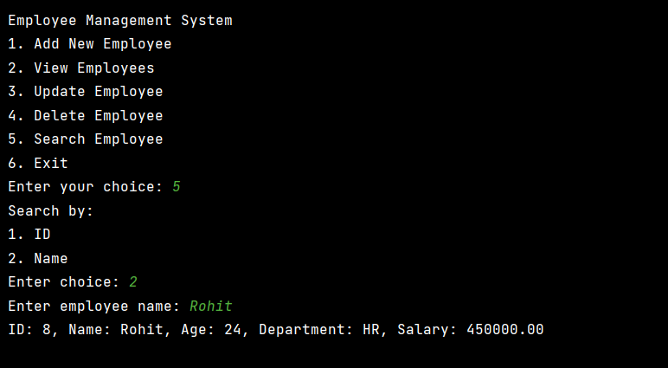
Search Particular Employee

Slide 16
Future Improvements
Web-based interface.
Role-based access control (different permissions for HR, manager, etc.).

Slide 17
Thank You!

